Slide 1
AOBO in CSP & ADRM with LightHouse
Arturo Quiroga
Senior Cloud Solutions Architect (CSA - OCP)
Microsoft Canada
https://Aka.ms/aqlighthouse

Slide 2
AGENDA
Introductions
Overview of Azure Delegated Resource Management
CSP Model
Lighthouse model
Lighthouse Overview & demos for the topics below
Azure Delegated Resource Management
Microsoft managed services resource provider
Using Lighthouse for offering Managed Services
Onboarding customers to Azure Lighthouse via the marketplace
Onboarding customers to Azure Lighthouse via templates
Security practices for Lighthouse
Comparing Lighthouse with CSP, using lighthouse and CSP together
Cross Tenant Management experience: some of the enhanced services and scenarios
Aggregation of Azure Security Center scores across tenants
Using Azure Resource Graph to query across customer tenants
Deploy and validate deployment of an Azure policy across multiple customer tenants

Slide 3
AOBO with CSP
CSP MODEL: A Partner Center CSP direct or indirect partner offer is accepted by customer, and the partner or reseller now has access to the Customer’s AAD tenant and manages the CSP Subscriptions on behalf of that customer, with the OWNER RBAC role (default).

Slide 4
Azure Delegated Resource Management - a.k.a Lighthouse
AZURE LIGHTHOUSE MODEL: Anyone can be an MSP. Whether it is a CSP partner, or a non CSP organization, any individual with an AAD tenant account can offer and be delegated the management of any kind of Azure Subscription, such as EA, CSP, PAYG, DIRECT, MSDN, FREE, etc, or the partner can be delegated just the management of specific Resource Group(s) on behalf of anybody else.

Slide 5
AOBO model via CSP (Partner Center)

Slide 6
CSP Models
1-Tier CSP (Direct)
1-Tier
2-Tier
Partners self-select based on criteria and business opportunity
Partners managed by Microsoft: PSE, Tele, Programmatic
Drives net new customers via differentiated offers & services
2-Tier reseller option for partners that don't meet criteria
Microsoft
Microsoft
1T CSP
2T CSP
Distributor
2T Reseller
2-Tier CSP Distributor (Indirect)
Selective recruitment; stringent criteria assessment
Partners fill scalability, capacity and capability opportunity
Drives net new customers via differentiated offers & services
Indirect sales via reseller partners
Customer
Customer
MicrosoftCSP.com

Slide 7
2T Reseller capabilities
2-Tier
The “authorized CSP Partner”
Provisioning capabilities
Partner Center & API access
Receives monthly invoice from Microsoft
Can enter “Reseller of Record” MPN ID on a subscription
Ensures end-customer is supported
Microsoft
2T CSP
Distributor
2T Reseller
Microsoft has limited visibility into these Partners
Not given provisioning capabilities
No API access
Must manually request delegated admin privileges from the customer
Customer
MicrosoftCSP.com

Slide 8
CSP AOBO by Direct Partners (1-tier)

Slide 9
Subscription is the default scope in Azure. Each subscription has its own set of roles. Resources and permissions do not bleed across subscriptions.
Azure AD and Azure resources are secured independently from one another.
That is, Azure AD role assignments do not grant access to Azure resources, and Azure role assignments do not grant access to Azure AD.
Role | Owner
Role | Contributor
Role | Reader
Azure
Resources
Role | Tenant Admin
Subscription 1
Role | Owner
Role | Contributor
Role | Reader
Azure
Resources
Subscription 2
Azure AD Tenant for Customer
Subscriptions belonging to Customer in Azure
Legend
Is member of
Can manage
Is partner of

Slide 10
Azure Active Directory and Azure Subscription permissions are separate and different
Azure AD Tenant Admins by default do not have management capabilities over Azure subscriptions in their tenant.
Role | Owner
Role | Contributor
Role | Reader
X
Azure
Resources
Role | Tenant Admin
Subscription 1
Role | Owner
Role | Contributor
Role | Reader
X
Azure
Resources
Subscription 2
Azure AD Tenant for Customer
Subscriptions belonging to Customer in Azure
Legend
Is member of
Can manage
Is partner of

Slide 11
Role | Owner
Role | Contributor
Role | Reader
Azure
Resources
Role | Tenant Admin
Subscription 1
User must be assigned role for a subscription before he/she can manage that subscription.
Role | Owner
Role | Contributor
Role | Reader
Azure
Resources
Subscription 2
Azure AD Tenant for Customer
Subscriptions belonging to Customer in Azure
Legend
Is member of
Can manage
Is partner of

Slide 12
Assigning Tenant Admin rights to the customer tenant does not give the partners rights to manage Azure subscriptions!
Group | Admin Agents
Role | Tenant Admin
Role | Owner
Role | Contributor
Role | Reader
X
Azure
Resources
Subscription 1 and 2
Azure AD Tenant for Partner
Azure AD Tenant for Customer
Subscriptions belonging to Customer in Azure
Legend
Is member of
Can manage
Is partner of

Slide 13
When a CSP partner creates an Azure subscription for a customer tenant, the partner Admin Agents group is automatically assigned subscription owner role.
Role | Owner
Role | Contributor
Role | Reader
Azure
Resources
Group | Admin Agents
Role | Tenant Admin
CSP Subscription
Role | Owner
Role | Contributor
Role | Reader
Azure
Resources
Subscription 1 and 2
Azure AD Tenant for Partner
Azure AD Tenant for Customer
Subscriptions belonging to Customer in Azure
Legend
Is member of
Can manage
Is partner of

Slide 14
Therefore, the partner Admin Agents group is able to manage resources in that subscription.
Role | Owner
Role | Contributor
Role | Reader
Azure
Resources
Group | Admin Agents
Role | Tenant Admin
CSP Subscription
Role | Owner
Role | Contributor
Role | Reader
Azure
Resources
Subscription 1 and 2
Azure AD Tenant for Partner
Azure AD Tenant for Customer
Subscriptions belonging to Customer in Azure
Legend
Is member of
Can manage
Is partner of

Slide 15
Partner can grant customer access to the Azure subscription by assigning customer a role to the subscription. (OPTIONAL)
Role | Owner
Role | Contributor
Role | Reader
Azure
Resources
Group | Admin Agents
Role | Tenant Admin
CSP Subscription
Role | Owner
Role | Contributor
Role | Reader
Azure
Resources
Subscription 1 and 2
Azure AD Tenant for Partner
Azure AD Tenant for Customer
Subscriptions belonging to Customer in Azure
Legend
Is member of
Can manage
Is partner of

Slide 16
CSP AOBO by Indirect Partners (2-tier)

Slide 17
Similar to 1-tier, after the Distributor creates a subscription for the customer, only the Distributor Admin Agents group is assigned Owner role to the Azure CSP subscription and can therefore manage the subscription. The Reseller does not yet have access to the Azure CSP subscription.
Role | Owner
Role | Contributor
Group | Admin Agents
Role | Reader
Azure
Resources
Distributor
Role | Tenant Admin
CSP Subscription
Role | Owner
Role | Contributor
Role | Reader
Group | Admin Agents
Azure
Resources
Non CSP Subscription 1 and 2
Reseller
Azure AD Tenant for Customer
Subscriptions belonging to Customer in Azure
Legend
Is member of
Can manage
Is partner of

Slide 18
In order for a reseller to get access to the subscription, the customer must first accept the Reseller as a partner. After being accepted as a partner, the Reseller Admin Agents still do not have access to the Azure CSP subscription.
Role | Owner
Role | Contributor
Group | Admin Agents
Role | Reader
Azure
Resources
Distributor
Role | Tenant Admin
CSP Subscription
Role | Owner
Role | Contributor
Role | Reader
Group | Admin Agents
Azure
Resources
Non CSP Subscription 1 and 2
Reseller
Azure AD Tenant for Customer
Subscriptions belonging to Customer in Azure
Legend
Is member of
Can manage
Is partner of

Slide 19
Once partnership is established, the Reseller’s Admin Agent group becomes a valid (external) principal from the customer tenant’s point of view. After which, the Reseller can request the Distributor to grant him/her a role to the Azure CSP subscription.
Role | Owner
Role | Contributor
Group | Admin Agents
Role | Reader
Azure
Resources
Distributor
Role | Tenant Admin
CSP Subscription
Role | Owner
Role | Contributor
Role | Reader
Group | Admin Agents
Azure
Resources
Non CSP Subscription 1 and2
Reseller
Azure AD Tenant for Customer
Subscriptions belonging to Customer in Azure
Legend
Is member of
Can manage
Is partner of

Slide 20
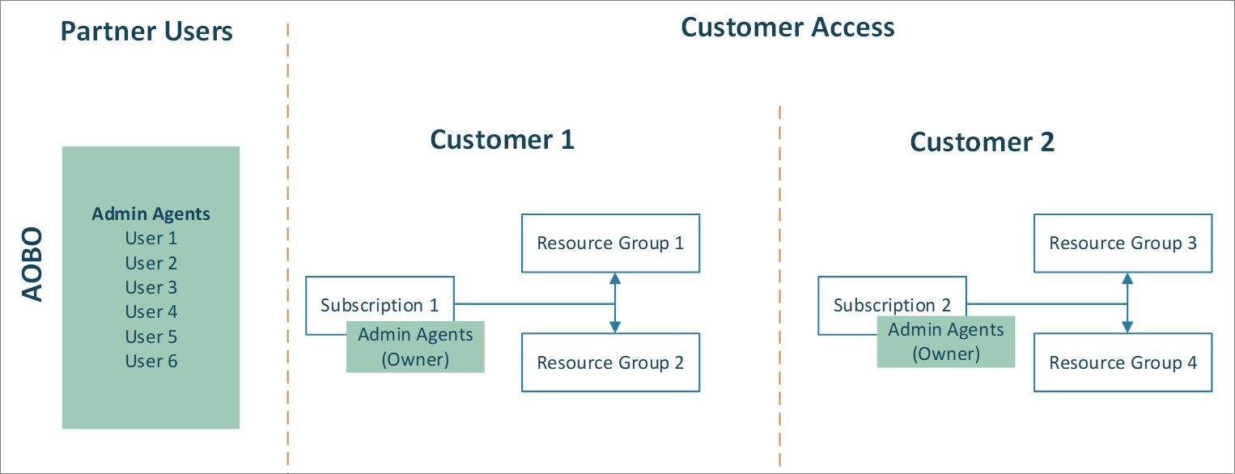
Summary of how AOBO works in CSP
With AOBO, any user with the Admin Agent role in your tenant will have, by default, AOBO/RBAC OWNER access to CSP Azure subscriptions that you create through the CSP program.
Any users who need access to any customers' subscriptions must be a member of this group. AOBO doesn’t allow the flexibility to create distinct groups that work with different customers, or to enable different roles for groups or users.

Slide 21
Azure Delegated Resource Management (ADRM) via Azure Lighthouse

Slide 22


Microsoft Azure Lighthouse

Slide 23
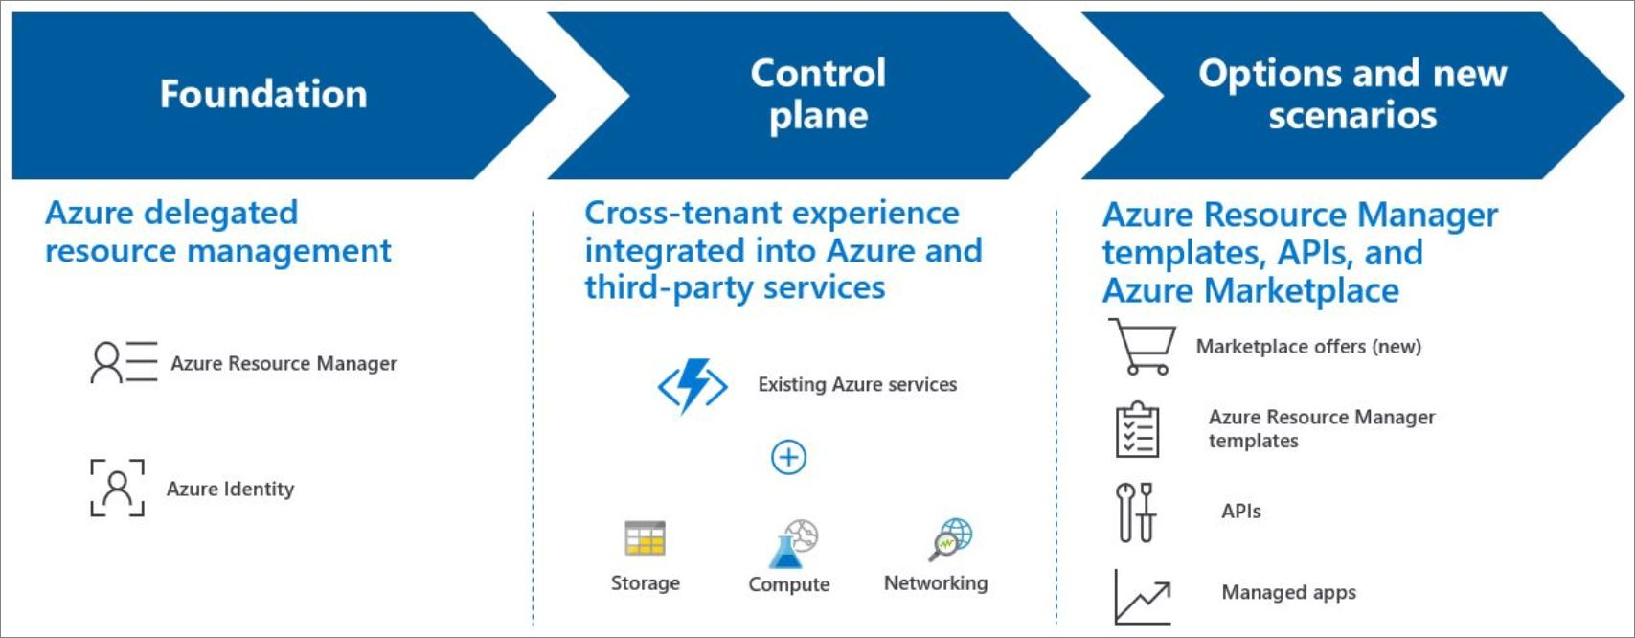
What is Azure Lighthouse?

Slide 24











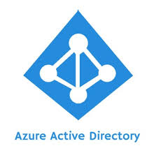

Azure Delegated Resource Management creates a logical (control plane) projection of the customer’s environment to the service provider
ARM validates the request is from a partner tenant and calls Managed Service Resource Provider (RP)
Managed service RP provides MSPs precise RBAC access
MSP completes the action on customer resource
1
MSP initiates an action for customer resource
2
3
4
CLI
Control plane
Existing 200+ Azure services
Azure Resource Management
PowerShell
Storage
Tags
RBAC
ARM Templates
Managed Services RP
Compute
REST API
Locks
Policy
Activity Log
c
Networking
Azure Portal
PaaS services

Slide 25
The Lighthouse architecture brings versatility and at-scale management capabilities into several scenarios
3
Accessing new customer markets, enabling partner to partner scenarios
Marketplace offers (new)
ARM Template
APIs
2
Cross-tenant experience integrated into Azure and third-party services
Azure Policy
Azure Monitor
Azure Security Center
Azure Portal
Azure Kubernetes Service (AKS)
Azure Virtual Network
And more…
Azure Delegated Resource Management foundational fabric – it uses the Managed Services RP
1
1
Azure Resource Manager (ARM)
Azure Identity
Notes:
ADRM is the core of how we think of cross customer management. We all know that the tools we build are only one part of the equation. We want to make sure our tools fit into the ecosystem of our Azure services and our partner community and how you operate. We’ve built ADRM to be the foundational management fabric that is based on ARM and Azure Identity. The cross tenant experience we talked about can show up in your Azure services – whether you are enabling Log Analytics or Policy or Networking for your customer and we’ll show you an instance of how one of our partners enabled this soon. We truly believe we are in the next frontier of the managed services with these capabilities extended into various scenarios and your preferred method of going to market to your customer – whether it is a marketplace offer that automatically gives you access to the customers environment when they accept or through ARM templates or APIs that you used or through managed Apps that can build your MSP service into a 3rd party ISV solution which they can sell to the end customer.

Slide 26
The secret sauce to Azure delegated resource management lies in being able to project customer resources into the partners environment
1
MSP connects to each customer cloud individually, takes 4X the amount of time
Customer resources, projected into MSP tenant to be managed by authorized MSP users
TODAY
LIGHTHOUSE
MSP can perform CRUD (Create, Read, Update, Delete) operations at scope
MSP tenant
MSP directory
MSP user group
Customer directory
Customer-1 Subscription
Customer-2 Subscription
Customer-3
Resource group
Customer-4 Resource group
Customer resources
Customer resources
Customer resources
Customer resources

Slide 27
Creating a Managed Services Offer in the Azure Marketplace.
Partners can publish a public or private managed services offer to Azure Marketplace using the Cloud Partner Portal, enabling a customer who purchases the offer to onboard resources for Azure delegated resource management.
https://docs.microsoft.com/en-us/azure/lighthouse/how-to/publish-managed-services-offers
You need to have a valid account in Partner Center to create and publish these offers. If you don’t have an account already, the sign-up process will lead you through the steps of creating an account in Partner Center and enrolling in the Commercial Marketplace program.
https://docs.microsoft.com/en-us/azure/marketplace/cloud-partner-portal-orig/cloud-partner-portal-getting-started-with-the-cloud-partner-portal
Your Microsoft Partner Network (MPN) ID will be automatically associated with the offers you publish to track your impact across customer engagements.
If you don't want to publish an offer to Azure Marketplace, you can onboard customers manually by using Azure Resource Manager templates. For more info, see Onboard a customer to Azure delegated resource management.

Slide 28
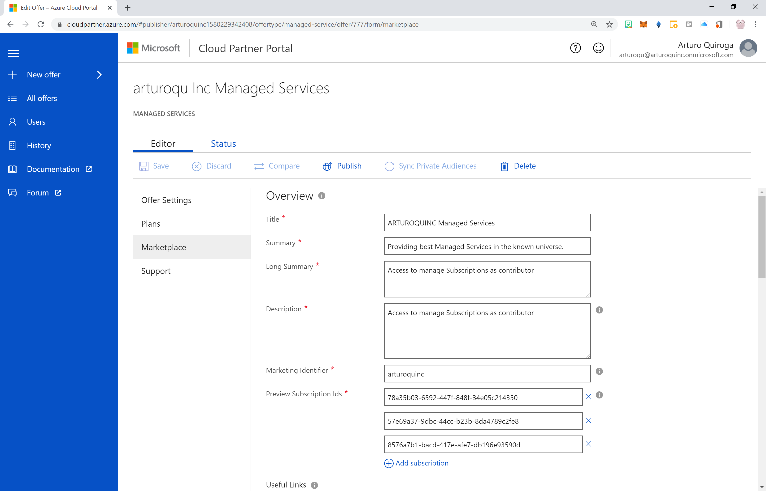
Example of an MSP offer in the Cloud Partner Portal

Slide 29
MarketPlace - Lighthouse Offer Creation DEMO
Partner Cloud Portal
Offer Settings
Plans
Marketplace
Support

Slide 30
The Lighthouse architecture brings versatility and at-scale management capabilities into several scenarios
3
Accessing new customer markets, enabling partner to partner scenarios
Marketplace offers (new)
ARM Template
APIs
2
Cross-tenant experience integrated into Azure and third-party services
Azure Policy
Azure Monitor
Azure Security Center
Azure Portal
Azure Kubernetes Service (AKS)
Azure Virtual Network
And more…
Azure Delegated Resource Management foundational fabric – it uses the Managed Services RP
1
1
Azure Resource Manager (ARM)
Azure Identity
See Lighthouse templates @ https://github.com/Azure/Azure-Lighthouse-samples/
Notes:
ADRM is the core of how we think of cross customer management. We all know that the tools we build are only one part of the equation. We want to make sure our tools fit into the ecosystem of our Azure services and our partner community and how you operate. We’ve built ADRM to be the foundational management fabric that is based on ARM and Azure Identity. The cross tenant experience we talked about can show up in your Azure services – whether you are enabling Log Analytics or Policy or Networking for your customer and we’ll show you an instance of how one of our partners enabled this soon. We truly believe we are in the next frontier of the managed services with these capabilities extended into various scenarios and your preferred method of going to market to your customer – whether it is a marketplace offer that automatically gives you access to the customers environment when they accept or through ARM templates or APIs that you used or through managed Apps that can build your MSP service into a 3rd party ISV solution which they can sell to the end customer.

Slide 31
Azure Lighthouse templates & parameters for offering Managed Services.
Field: | Definition:
mspOfferName | A name describing this definition. This value is displayed to the customer as the title of the offer.
mspOfferDescription | A brief description of your offer (for example, "Contoso VM management offer").
managedByTenantId | Your tenant ID.
authorizations | The principalId values for the users/groups/SPNs from your tenant, each with a principalIdDisplayName to help your customer understand the purpose of the authorization, and mapped to a built-in roleDefinitionId value to specify the level of access (RBAC role)
To onboard this: | Use this Azure Resource Manager template: | And modify this parameter file:
Subscription | delegatedResourceManagement.json | delegatedResourceManagement.parameters.json
Resource group | rgDelegatedResourceManagement.json | rgDelegatedResourceManagement.parameters.json
Multiple resource groups within a subscription | multipleRgDelegatedResourceManagement.json | multipleRgDelegatedResourceManagement.parameters.json
Subscription (when using an offer published to Azure Marketplace) | marketplaceDelegatedResourceManagement.json | marketplaceDelegatedResourceManagement.parameters.jso
https://docs.microsoft.com/en-us/azure/lighthouse/overview
https://docs.microsoft.com/en-us/azure/role-based-access-control/built-in-roles
https://docs.microsoft.com/en-us/azure/lighthouse/samples/
https://github.com/Azure/Azure-Lighthouse-samples

Slide 32
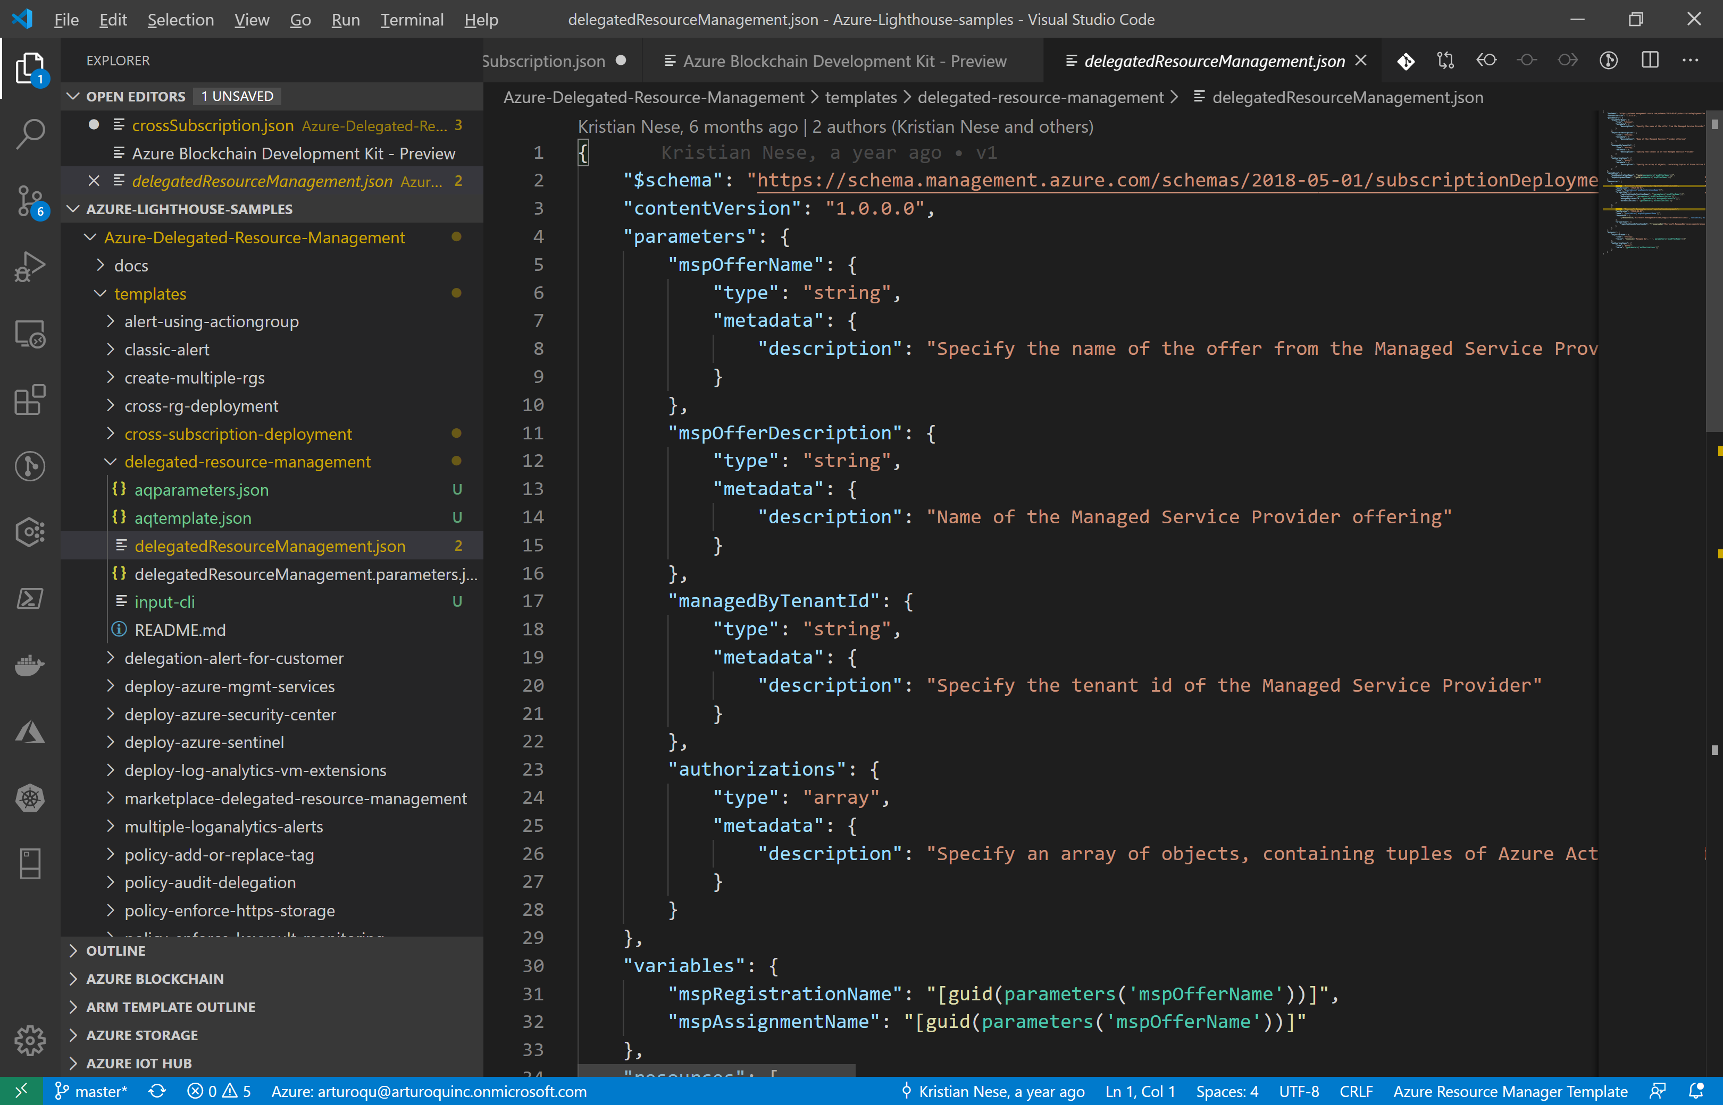
Azure Lighthouse templates in Visual Studio Code

Slide 33
Lighthouse MSP Offer - Template file (JSON) for MSP’s offer to customer.
{
"$schema": "https://schema.management.azure.com/schemas/2018-05-01/subscriptionDeploymentTemplate.json#",
"contentVersion": "1.0.0.0",
"parameters": {
"mspOfferName": {
"type": "string",
"metadata": {
"description": "Specify the name of the offer from the Managed Service Provider"
}
},
"mspOfferDescription": {
"type": "string",
"metadata": {
"description": "Name of the Managed Service Provider offering"
}
},
"managedByTenantId": {
"type": "string",
"metadata": {
"description": "Specify the tenant id of the Managed Service Provider"
}
},
"authorizations": {
"type": "array",
"metadata": {
"description": "Specify an array of objects, containing tuples of Azure Active Directory principalId, a Azure roleDefinitionId, and an optional principalIdDisplayName. The roleDefinition specified is granted to the principalId in the provider's Active Directory and the principalIdDisplayName is visible to customers."
}
}
},
"variables": {
"mspRegistrationName": "[guid(parameters('mspOfferName'))]",
"mspAssignmentName": "[guid(parameters('mspOfferName'))]"
},

Slide 34
Lighthouse MSP Offer - Parameter file (JSON) for MSP’s offer to customer.
{
"$schema": "https://schema.management.azure.com/schemas/2015-01-01/deploymentParameters.json#",
"contentVersion": "1.0.0.0",
"parameters": {
"mspOfferName": {
"value": ”Managed Services Offering from XXXX” # Make this Name something compelling and enticing to the customer
},
"mspOfferDescription": {
"value": ”Service to manage XXXX, with permissions XXXX” # Make this a good description of your offer.
},
"managedByTenantId": {
"value": "5a3326ad-f43f-480d-85b2-26b386f0ae20” # This is the GUID of the AAD Tenant of the provider
},
"authorizations": {
"value": [
{
"principalId": "68e05db2-275a-4b82-9a03-c2b1a7249775", # In this case we have defined one principal IDs from # the provider AAD tenant, either for a user or group, # in GUID format.
"roleDefinitionId": "b24988ac-6180-42a0-ab88-20f7382dd24c", # This is the requested delegated role, also in # GUID format, in this case “contributor” role.
"principalIdDisplayName": "Tier 1 Support”
},
]
}

Slide 35
How to onboard a customer using Azure POWERSHELL Deploy the Lighthouse Azure Resource Manager templates/parameters
# Log in first with Connect-AzAccount if you're not using Cloud Shell ……(really?...use Cloud Shell)
# Deploy Azure Resource Manager template using template and parameter file locally
New-AzDeployment -Name <deploymentName> ` # If you get an error, remove -name
-Location <AzureRegion> `
-TemplateFile <pathToTemplateFile> `
-TemplateParameterFile <pathToParameterFile> `
-Verbose
# Or
# Deploy Azure Resource Manager template that is located externally
New-AzDeployment -Name <deploymentName> ` # If you get an error, remove -name
-Location <AzureRegion> `
-TemplateUri <templateUri> `
-TemplateParameterUri <parameterUri> `
-Verbose
Get-AzContext
Get-AzManagedServicesAssignment -Scope "/subscriptions/{delegatedSubscriptionId}"

Slide 36
How to onboard a customer using Azure CLI Deploy the Lighthouse Azure Resource Manager templates/parameters
# Log in first with az login if you're not using Cloud Shell (preferred way is to use Azure Cloud Shell)
# Deploy Azure Resource Manager template using template and parameter file locally
az deployment create –name <deploymentName> \ # If you get an error, remove --name
--location <AzureRegion> \
--template-file <pathToTemplateFile> \
--parameters <parameters/parameterFile> \
--verbose
# Or
# Deploy external Azure Resource Manager template, with local parameter file
az deployment create –name <deploymentName \ # If you get an error, remove --name
--location <AzureRegion> \
--template-uri <templateUri> \
--parameters <parameterFile> \
--verbose
az account list
az managedservices assignment list

Slide 37
ARM Templates - Lighthouse Offer Creation DEMO
Creating an offer via ARM templates
Lighthouse View from Customers perspective
Lighthouse View from MSP perspective
Lighthouse and Azure Arc (optional)
Customer Deleting an offer from an MSP

Slide 38
Azure Lighthouse Demo Environment
offer
Production
BIG-Production
offer
Development
BIG-Test
Test
ARTUROQUINC
BIGCUSTOMER
offer
ARTURO-OCP
Customers
RG1
RG2
MICROSOFT
BIGMSP
offer
MTC
(on-premises)
MSDN-SUB
Managed Services Providers
SMALLCUSTOMER
Azure Arc for Servers

Slide 39
Summary of how AOBO works in CSP
With AOBO, any user with the Admin Agent role in your tenant will have, by default, AOBO/RBAC OWNER access to CSP Azure subscriptions that you create through the CSP program.
Any users who need access to any customers' subscriptions must be a member of this group. AOBO doesn’t allow the flexibility to create distinct groups that work with different customers, or to enable different roles for groups or users.

Slide 40
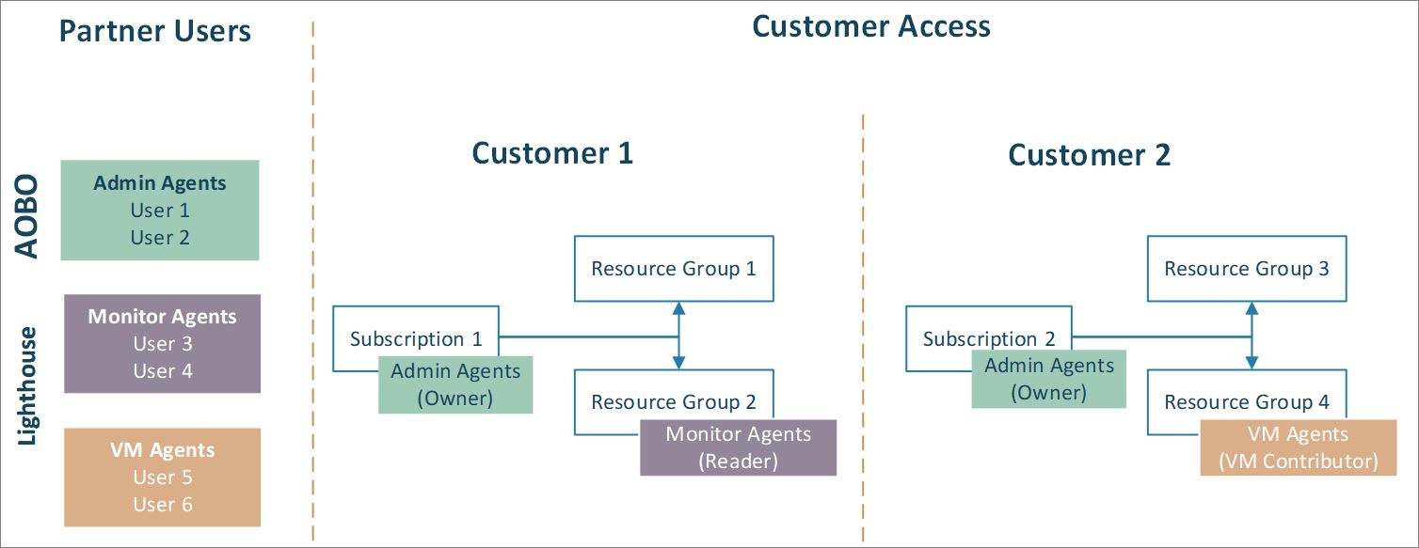
Combining AOBO with CSP & Delegated Resource Management Lighthouse
Using Azure delegated resource management, you can assign different groups to different customers or roles, as shown in the diagram.
Because users will have the appropriate level of access through Azure delegated resource management (RBAC), you can reduce the number of users who have the Admin Agent role (and thus have full AOBO access). This helps improve security by limiting unnecessary access to your customers’ resources. It also gives you more flexibility to manage multiple customers at scale.

Slide 41
Cross Tenant Management experience
https://docs.microsoft.com/en-us/azure/lighthouse/concepts/cross-tenant-management-experience#enhanced-services-and-scenarios

Slide 42
Azure Lighthouse Cross Tenant Management Experience DEMO
Filtering Directories and Subscriptions
Azure Security Center
Azure Activity log

Slide 43
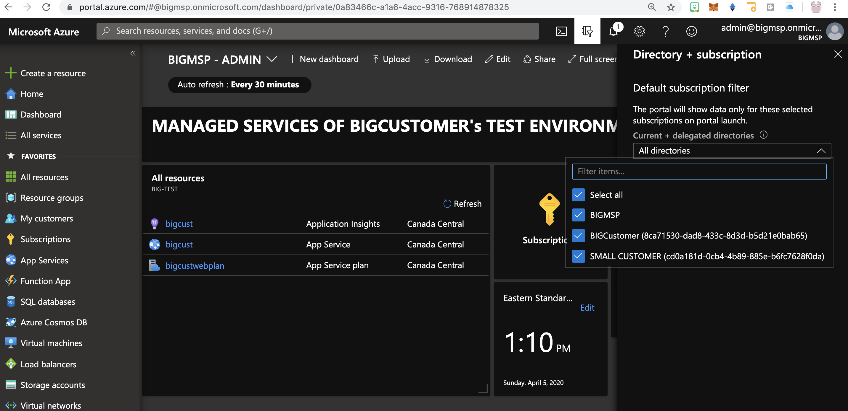
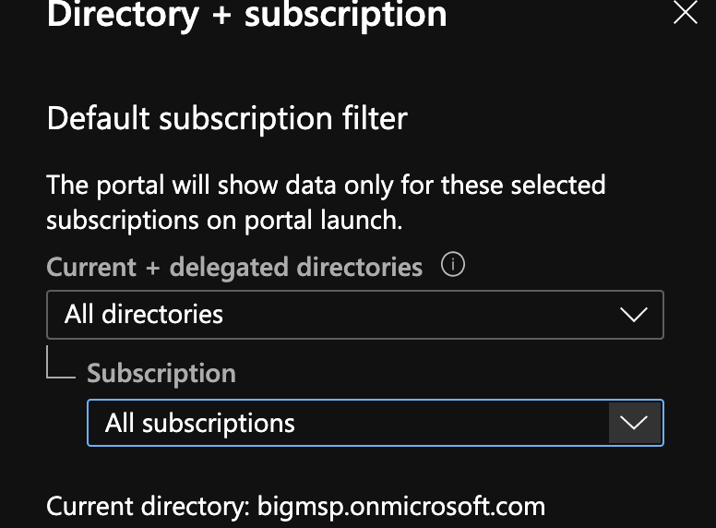
MSP view - Filtering Directories

Slide 44
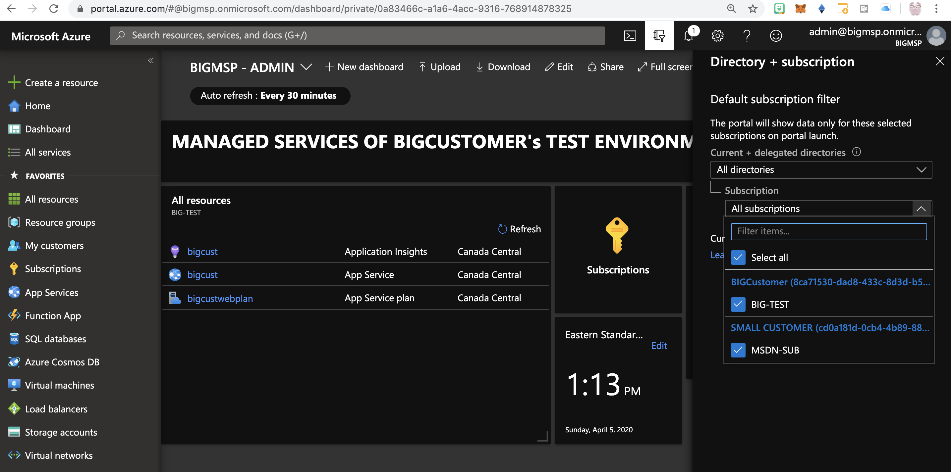
MSP View – Filtering Subscriptions

Slide 45
Use Azure Resource Graph to query across customer tenants
You can use Azure Resource Graph to query across all subscriptions in the customer tenants that you manage.
In this example, we’ll identify any storage accounts in these subscriptions that do not currently require HTTPS traffic.
$MspTenant = "insert your managing tenantId here"
$subs = Get-AzSubscription
$ManagedSubscriptions = Search-AzGraph -Query "ResourceContainers | where type == 'microsoft.resources/subscriptions' | where tenantId != '$($mspTenant)' | project name, subscriptionId, tenantId" -subscription $subs.subscriptionId
Search-AzGraph -Query "Resources | where type =~ 'Microsoft.Storage/storageAccounts' | project name, location, subscriptionId, tenantId, properties.supportsHttpsTrafficOnly" -subscription $ManagedSubscriptions.subscriptionId | convertto-json

Slide 46
Deploy a policy across multiple customer tenants
The example below shows how to use an Azure Resource Manager template to deploy a policy definition and policy assignment across delegated subscriptions in multiple customer tenants.
This policy definition requires all storage accounts to use HTTPS traffic, preventing the creation of any new storage accounts that don’t comply and marking existing storage accounts without the setting as non-compliant.
Write-Output "In total, there are $($ManagedSubscriptions.Count) delegated customer subscriptions to be managed"
foreach ($ManagedSub in $ManagedSubscriptions)
{
Select-AzSubscription -SubscriptionId $ManagedSub.subscriptionId
New-AzDeployment -Name mgmt `
-Location eastus `
-TemplateUri "https://raw.githubusercontent.com/Azure/Azure-Lighthouse-samples/master/Azure-Delegated-Resource-Management/templates/policy-enforce-https-storage/enforceHttpsStorage.json" `
-AsJob
}

Slide 47
Validate the policy deployment
After you’ve deployed the Azure Resource Manager template, you can confirm that the policy definition was successfully applied by attempting to create a storage account with EnableHttpsTrafficOnly set to false in one of your delegated subscriptions.
Because of the policy assignment, you should be unable to create this storage account.
New-AzStorageAccount -ResourceGroupName (New-AzResourceGroup -name policy-test -Location eastus -Force).ResourceGroupName `
-Name (get-random) `
-Location eastus `
-EnableHttpsTrafficOnly $false `
-SkuName Standard_LRS ` -Verbose

Slide 48
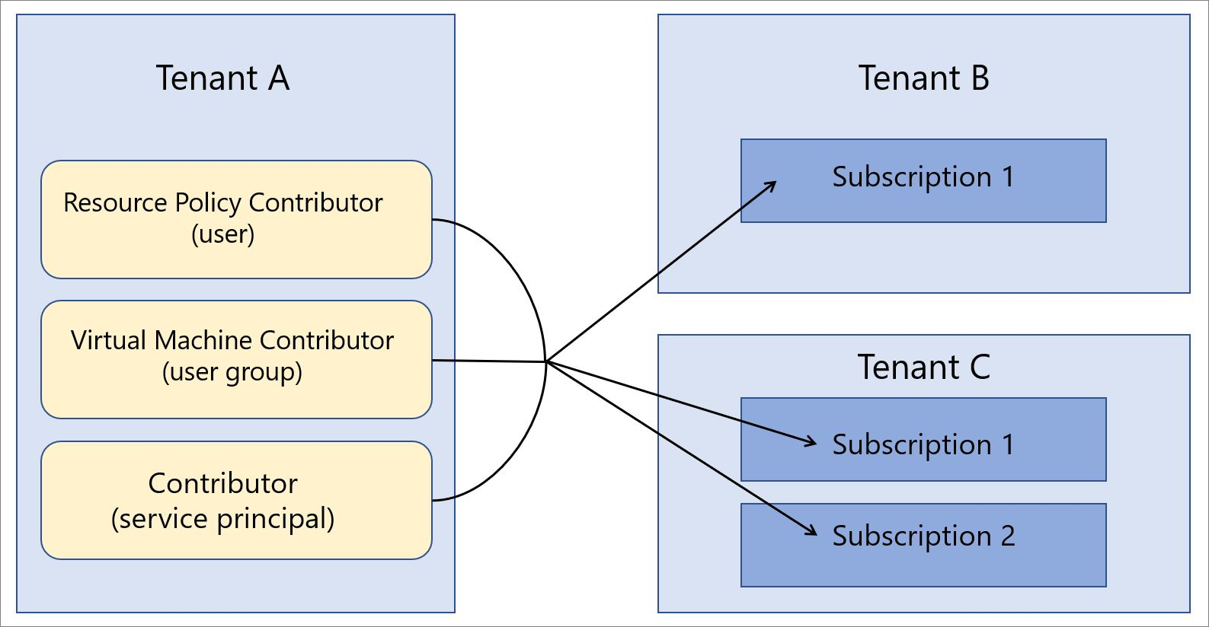
Azure Lighthouse in Enterprise Scenarios or in CSP

Slide 49
Recommended Security Practices
When using Azure delegated resource management, it’s important to consider security and access control.
Users in your tenant will have direct access to customer subscriptions and resource groups, so you’ll want to take steps to maintain your tenant’s security.
You’ll also want to make sure you only allow the access that’s needed to effectively manage your customers’ resources.
Require Azure Multi-Factor Authentication
Azure Multi-Factor Authentication (also known as two-step verification) helps prevent attackers from gaining access to an account by requiring multiple authentication steps.
You should require Multi-Factor Authentication for all users in your service provider tenant, including any users who will have access to customer resources.
We suggest that you ask your customers to implement Azure Multi-Factor Authentication in their tenants as well.
Assign permissions to groups, using the principle of least privilege
To make management easier, we recommend using Azure AD user groups for each role required to manage your customers’ resources. This lets you add or remove individual users to the group as needed, rather than assigning permissions directly to that user.
When creating your permission structure, be sure to follow the principle of least privilege so that users only have the permissions needed to complete their job, helping to reduce the chance of inadvertent errors.

Slide 50
APPENDIX

Slide 51
Azure Lighthouse Demo Environment
offer
Production
BIG-Production
offer
Development
BIG-Test
Test
ARTUROQUINC
BIGCUSTOMER
offer
ARTURO-OCP
Customers
RG1
RG2
MICROSOFT
BIGMSP
offer
MTC
(on-premises)
MSDN-SUB
Managed Services Providers
SMALLCUSTOMER
Azure Arc for Servers

Slide 52
PowerShell commands: Az.ManagedServices
Get-AzManagedServicesAssignment | Gets a list of the registration assignments.
Get-AzManagedServicesDefinition | Gets a list of the registration definitions.
New-AzManagedServicesAssignment | Creates a registration assignment.
New-AzManagedServicesDefinition | Creates a registration definition.
Remove-AzManagedServicesAssignment | Deletes the registration assignment.
Remove-AzManagedServicesDefinition | Deletes the registration definition.

Slide 53
CLI commands: az managedservices
az managedservices assignment | Manage the registration assignments in Azure.
az managedservices assignment create | Creates a new registration assignment.
az managedservices assignment delete | Deletes the registration assignment.
az managedservices assignment list | List all the registration assignments.
az managedservices assignment show | Gets a registration assignment.
az managedservices definition | Manage the registration definitions in Azure.
az managedservices definition create | Creates a new registration definition.
az managedservices definition delete | Deletes a registration.
az managedservices definition list | List all the registration definitions under the default scope or under the subscription provided.
az managedservices definition show | Gets a registration definition.

